Slide 1
William Stallings
Data and Computer Communications
7th Edition
Chapter 5
Signal Encoding Techniques

Slide 2
Digital Data, Analog Signal
Public telephone system
  300Hz to 3400Hz
  Use modem (modulator-demodulator)
Amplitude shift keying (ASK)
Frequency shift keying (FSK)
Phase shift keying (PK)

Slide 3
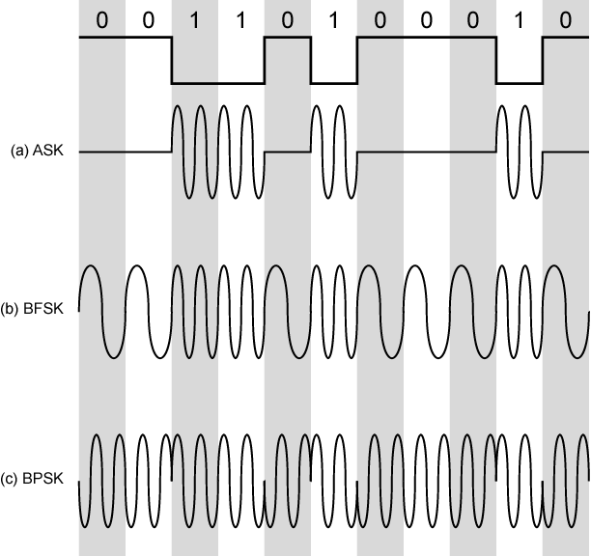
Modulation Techniques

Slide 4
Amplitude Shift Keying
Values represented by different amplitudes of carrier
Usually, one amplitude is zero
  i.e. presence and absence of carrier is used
Susceptible to sudden gain changes
Inefficient
Up to 1200bps on voice grade lines
Used over optical fiber

Slide 5
Binary Frequency Shift Keying
Most common form is binary FSK (BFSK)
Two binary values represented by two different frequencies (near carrier)
Less susceptible to error than ASK
Up to 1200bps on voice grade lines
High frequency radio
Even higher frequency on LANs using co-ax

Slide 6
Multiple FSK
More than two frequencies used
More bandwidth efficient
More prone to error
Each signalling element represents more than one bit

Slide 7
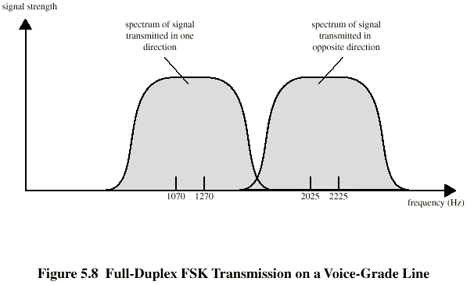
FSK on Voice Grade Line

Slide 8
Phase Shift Keying
Phase of carrier signal is shifted to represent data
Binary PSK
  Two phases represent two binary digits
Differential PSK
  Phase shifted relative to previous transmission rather than some reference signal

Slide 9
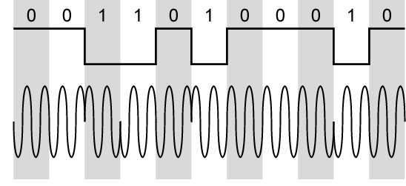
Differential PSK

Slide 10
Quadrature PSK
More efficient use by each signal element representing more than one bit
  e.g. shifts of π/2 (90º)
  Each element represents two bits
  Can use 8 phase angles and have more than one amplitude
  9600bps modem use 12 angles , four of which have two amplitudes
Offset QPSK (orthogonal QPSK)
  Delay in Q stream

Slide 11
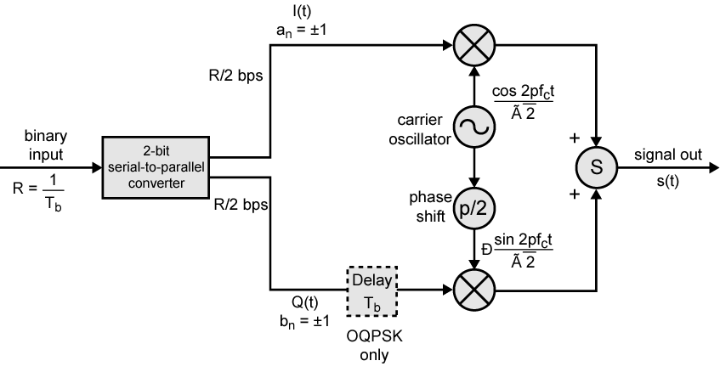
QPSK and OQPSK Modulators

Slide 12
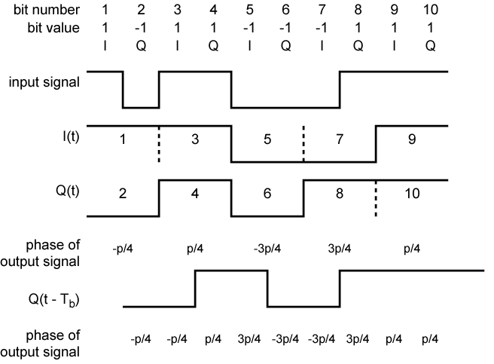
Examples of QPSF and OQPSK Waveforms

Slide 13
Performance of Digital to Analog Modulation Schemes
Bandwidth
  ASK and PSK bandwidth directly related to bit rate
  FSK bandwidth related to data rate for lower frequencies, but to offset of modulated frequency from carrier at high frequencies
  (See Stallings for math)
In the presence of noise, bit error rate of PSK and QPSK are about 3dB superior to ASK and FSK

Slide 14
Quadrature Amplitude Modulation
QAM used on asymmetric digital subscriber line (ADSL) and some wireless
Combination of ASK and PSK
Logical extension of QPSK
Send two different signals simultaneously on same carrier frequency
  Use two copies of carrier, one shifted 90°
  Each carrier is ASK modulated
  Two independent signals over same medium
  Demodulate and combine for original binary output

Slide 15
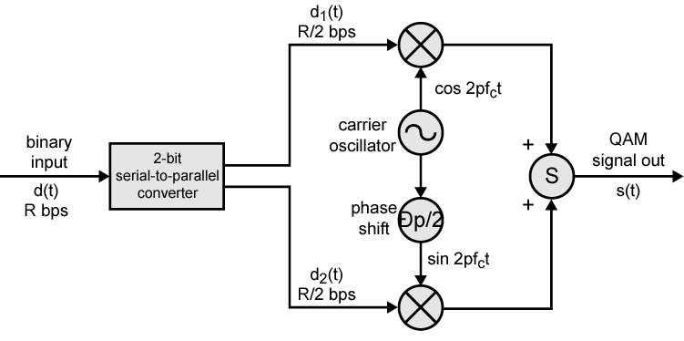
QAM Modulator

Slide 16
QAM Levels
Two level ASK
  Each of two streams in one of two states
  Four state system
  Essentially QPSK
Four level ASK
  Combined stream in one of 16 states
64 and 256 state systems have been implemented
Improved data rate for given bandwidth
  Increased potential error rate

Slide 17
Analog Data, Digital Signal
Digitization
  Conversion of analog data into digital data
  Digital data can then be transmitted using NRZ-L
  Digital data can then be transmitted using code other than NRZ-L
  Digital data can then be converted to analog signal
  Analog to digital conversion done using a codec
  Pulse code modulation
  Delta modulation

Slide 18
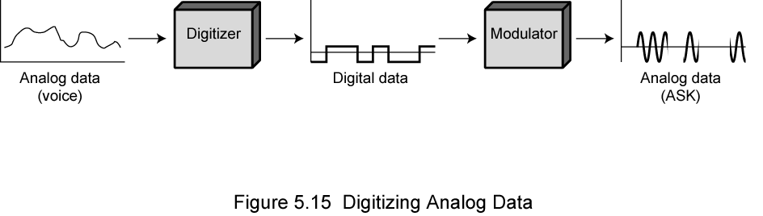
Digitizing Analog Data

Slide 19
Pulse Code Modulation(PCM) (1)
If a signal is sampled at regular intervals at a rate higher than twice the highest signal frequency, the samples contain all the information of the original signal
  (Proof - Stallings appendix 4A)
Voice data limited to below 4000Hz
Require 8000 sample per second
Analog samples (Pulse Amplitude Modulation, PAM)
Each sample assigned digital value

Slide 20
Pulse Code Modulation(PCM) (2)
4 bit system gives 16 levels
Quantized
  Quantizing error or noise
  Approximations mean it is impossible to recover original exactly
8 bit sample gives 256 levels
Quality comparable with analog transmission
8000 samples per second of 8 bits each gives 64kbps

Slide 21
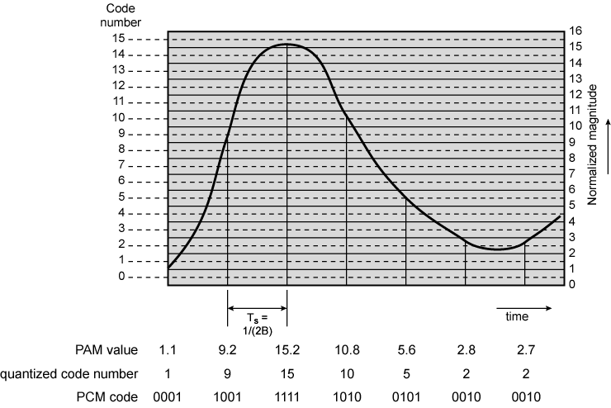
PCM Example

Slide 22
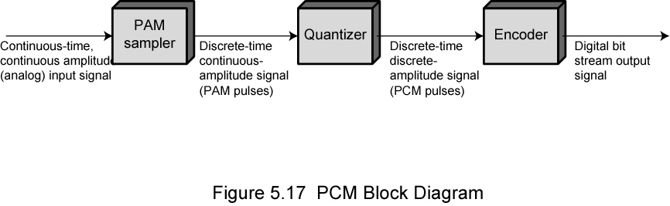
PCM Block Diagram

Slide 23
Nonlinear Encoding
Quantization levels not evenly spaced
Reduces overall signal distortion
Can also be done by companding

Slide 24
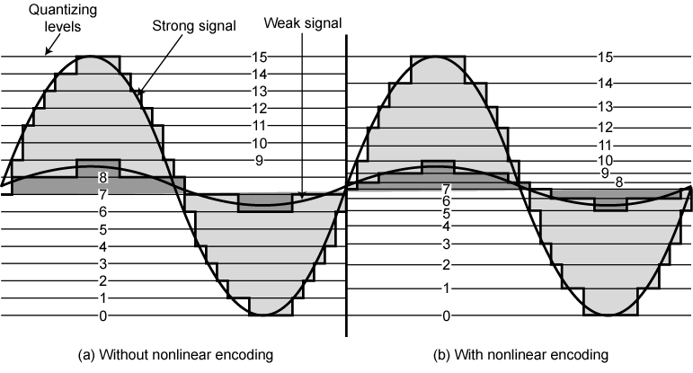
Effect of Non-Linear Coding

Slide 25
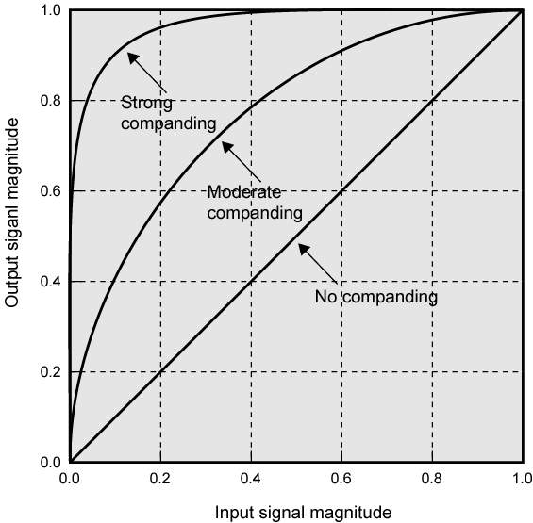
Typical Companding Functions

Slide 26
Delta Modulation
Analog input is approximated by a staircase function
Move up or down one level (δ) at each sample interval
Binary behavior
  Function moves up or down at each sample interval

Slide 27
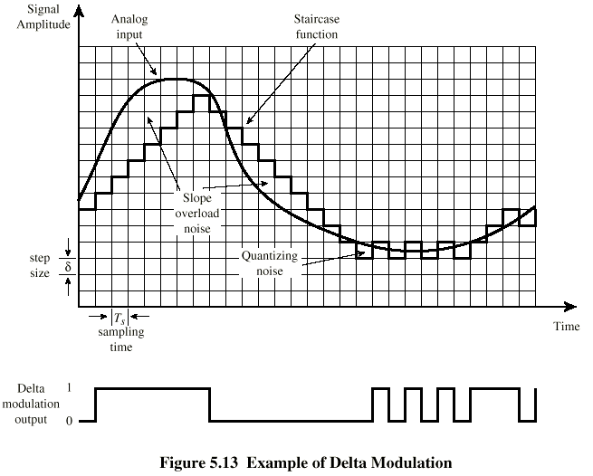
Delta Modulation - example

Slide 28
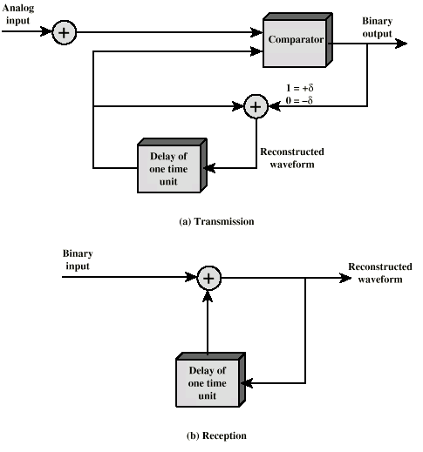
Delta Modulation - Operation

Slide 29
Delta Modulation - Performance
Good voice reproduction
  PCM - 128 levels (7 bit)
  Voice bandwidth 4khz
  Should be 8000 x 7 = 56kbps for PCM
Data compression can improve on this
  e.g. Interframe coding techniques for video

Slide 30
Analog Data, Analog Signals
Why modulate analog signals?
  Higher frequency can give more efficient transmission
  Permits frequency division multiplexing (chapter 8)
Types of modulation
  Amplitude
  Frequency
  Phase

Slide 31
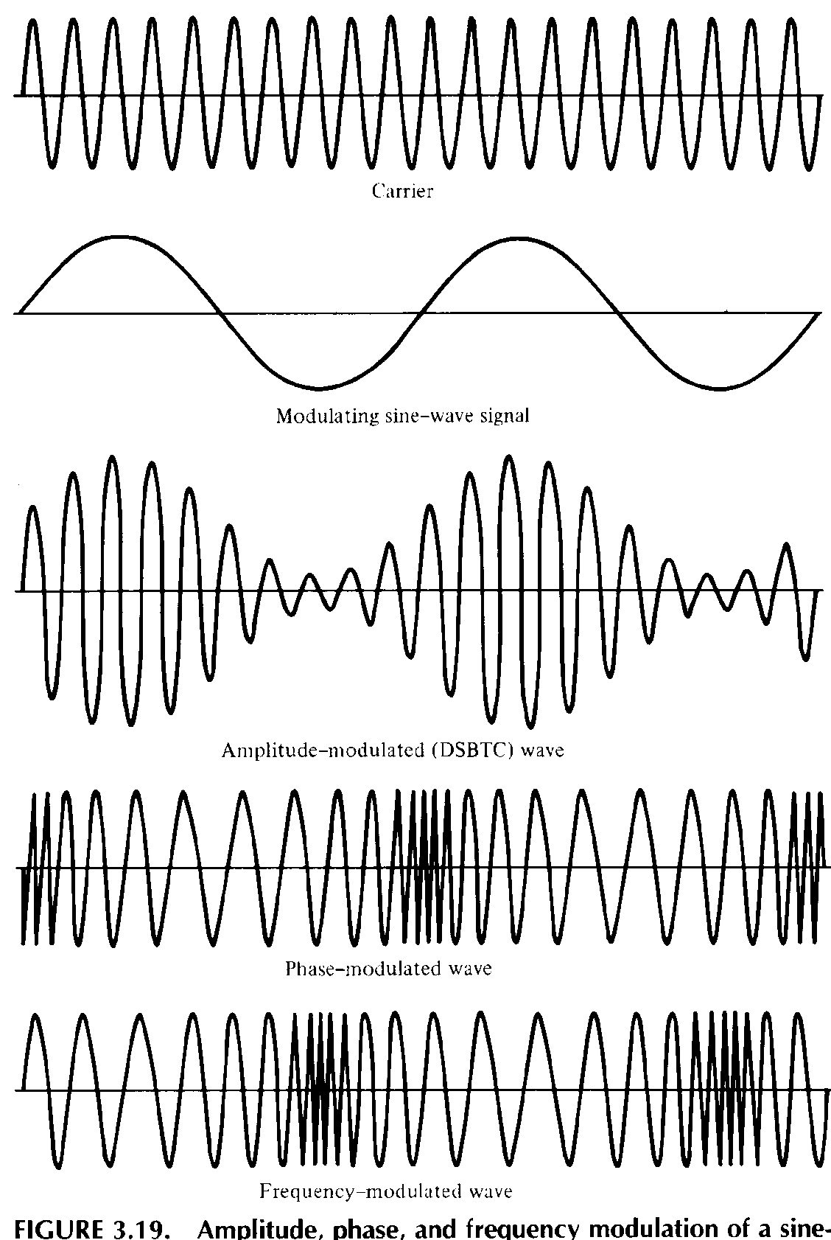
Analog
Modulation

Slide 32
Required Reading
Stallings chapter 5

